Slide 1

modern news website
presentation by:
Daksh Patel
Rhythm Patel
Bhavya Patel
Labana Babu

Slide 2

Introduction to the Modern News Project
The Modern News Project is an innovative platform that showcases the latest news across various domains, including IPL, finance, and politics. It's designed using HTML, CSS, and JavaScript, offering a seamless and interactive user experience.

Slide 3
Overview of the project's features
Multi-category News
Interactive Search
Responsive Design
The project provides news on diverse topics such as sports (IPL), finance, and politics, catering to a wide range of interests.
Users can utilize the search feature to easily find specific news or articles based on their preferences.
The platform is built with a responsive layout, ensuring a seamless experience across various devices.

Slide 4
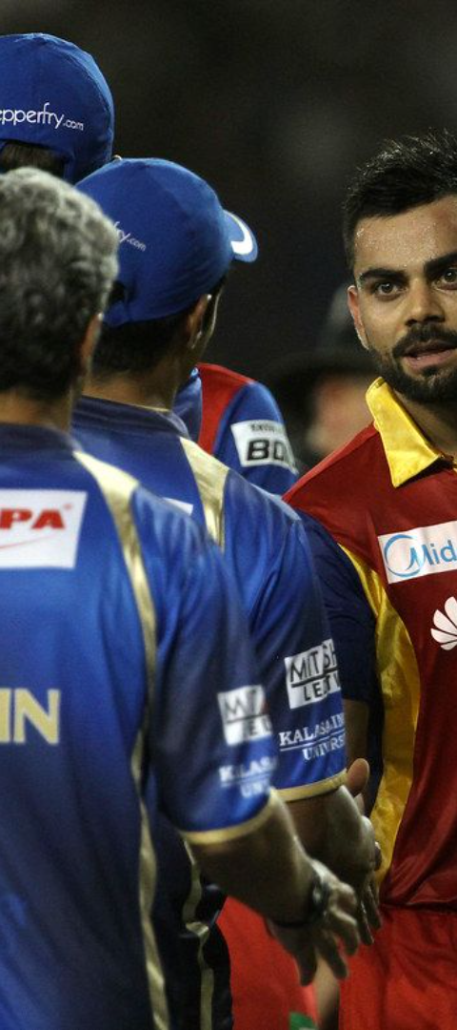
IPL News Section
1
Live Match Updates
2
Player Interviews
Real-time coverage of IPL matches with scores and player highlights.
Exclusive interviews with cricketers, coaches, and team owners.
3
Analysis & Insights
Detailed analysis of match strategies, player performances, and team standings.

Slide 5
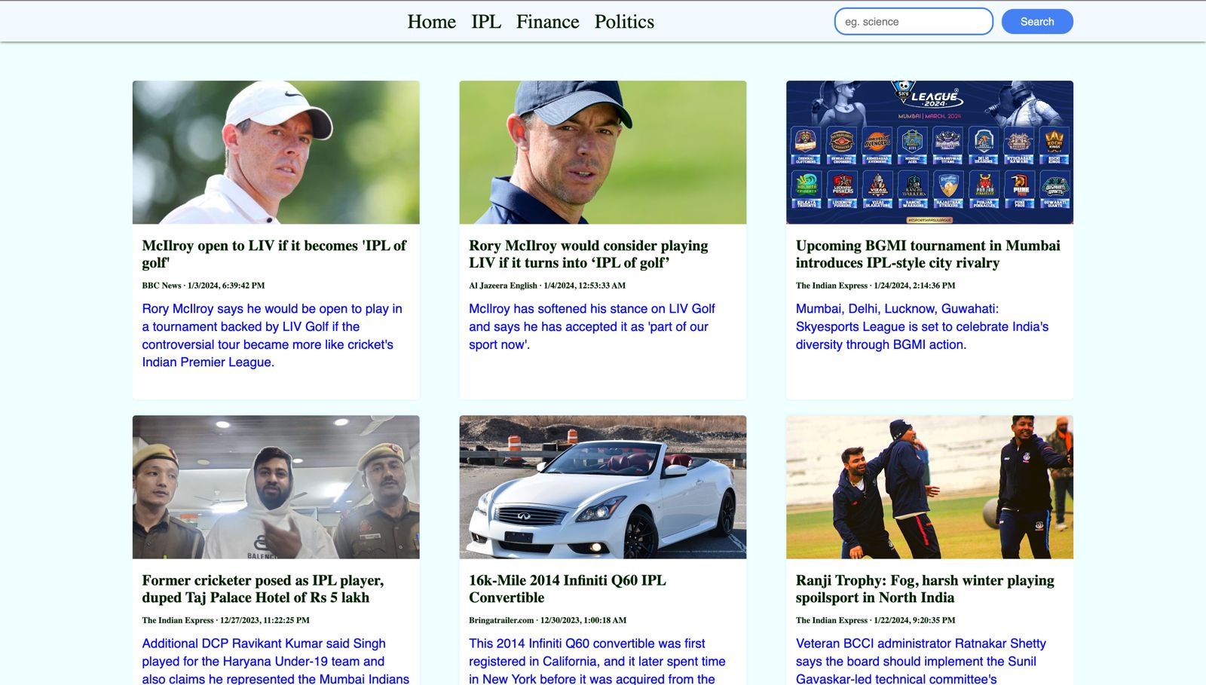

Slide 6

Finance News Section
Market Trends
Investment Tips
Global Finance News
Insights into stock market trends, cryptocurrency updates, and economic indicators.
Valuable advice on smart investment opportunities and wealth management strategies.
Highlighting major financial events and developments from around the world.

Slide 7
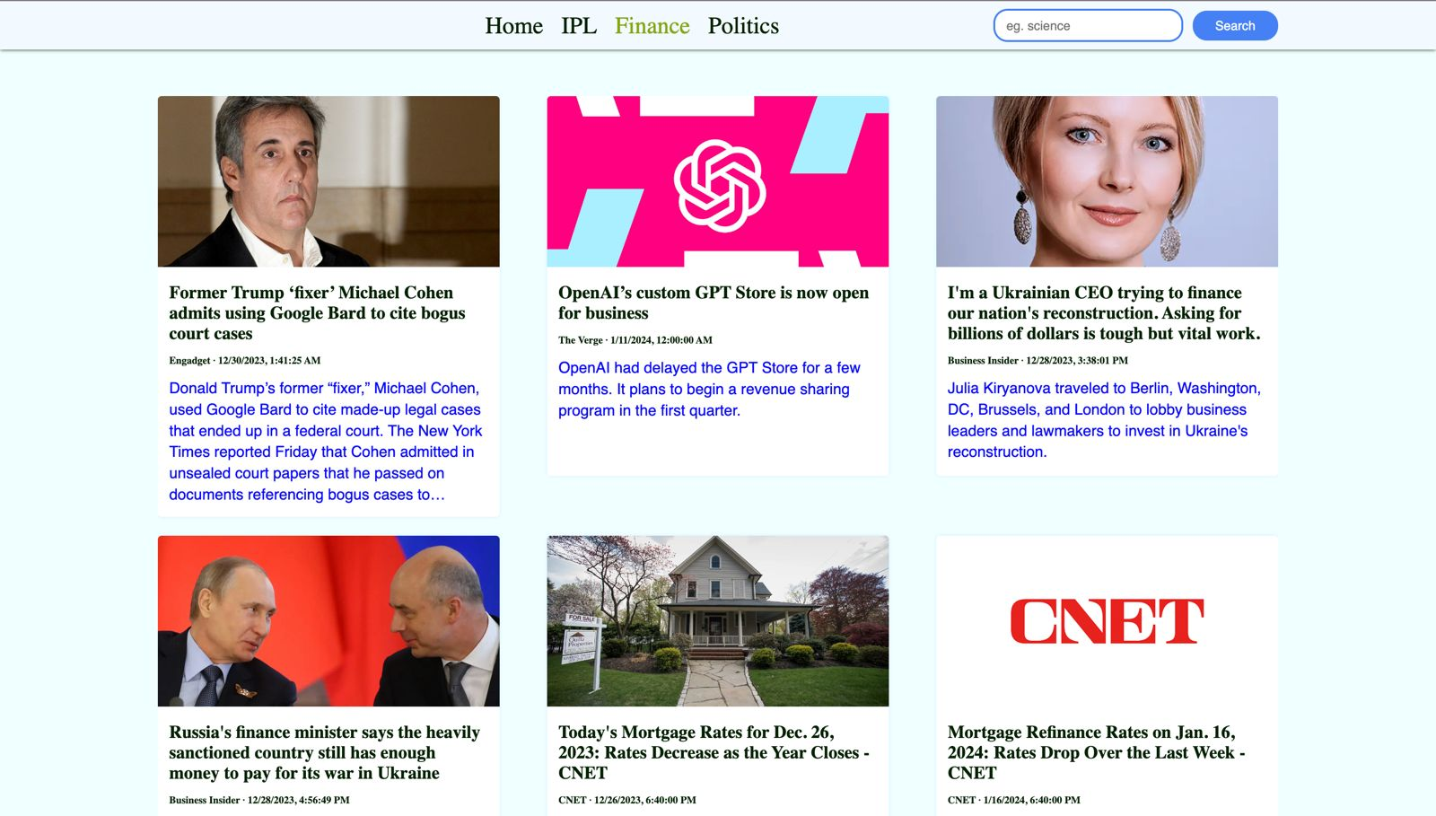

Slide 8
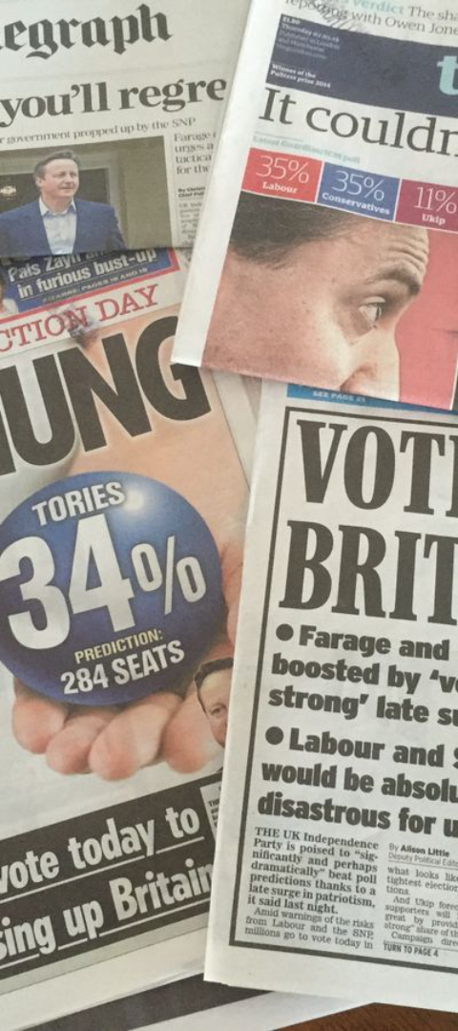
Politics News Section
1
Election Updates
Comprehensive coverage of local and global elections, including candidate profiles and voting trends.
2
Policy Analysis
Detailed insights into policy changes, government decisions, and their societal impact.
3
Interviews & Opinions
Exclusive interviews with political leaders and editorials on key political issues.

Slide 9




Search Feature
Easy Navigation
Intuitive search functionality for users to quickly find specific news or topics of interest.
Filter Options
Customizable filters for refining search results based on categories, dates, and keywords.
Instant Results
Real-time search outcomes for swift access to the latest news updates across all sections.

Slide 10
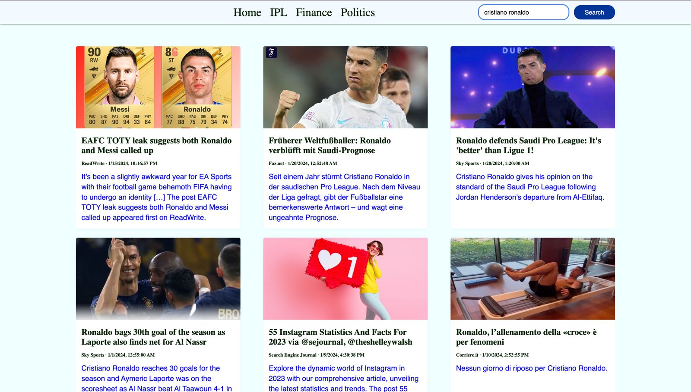

Slide 11
Technical Details: HTML, CSS, JavaScript, and API
HTML Structure:
Employ semantic HTML tags for content structure.
Use HTML5 features for improved compatibility.
CSS Styling:
Implement a mobile-first design strategy using media queries.
Ensure clean and maintainable styles for consistency.
JavaScript Interactivity:
Utilize JavaScript for dynamic content updates.
Implement AJAX to fetch and display real-time data.
Enhance user experience with smooth transitions.
API Integration:
Connect to news APIs for fetching latest articles.
Parse and format API responses for seamless integration.
Handle errors gracefully for a robust user experience.

Slide 12
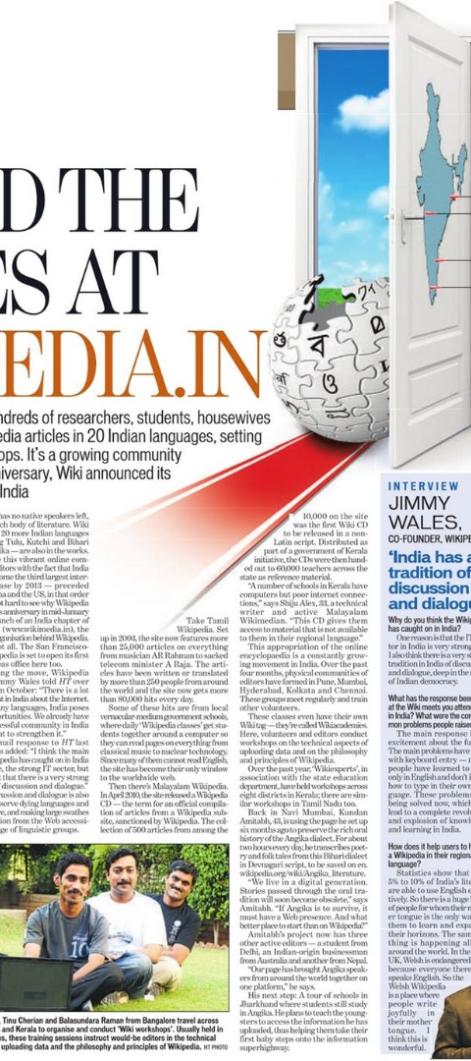
Future Plans for the Project
1
Mobile App Development
2
AI Integration
Expanding the platform with a dedicated mobile app for seamless news access on smartphones and tablets.
Implementing AI-driven features for personalized news recommendations and content curation.
3
Global Expansion
Introducing multilingual support and worldwide news coverage to cater to an international audience.

Slide 13
Conclusion
Comprehensive Coverage
User-Friendly Experience
Continuous Improvement
Wide array of news categories covered
Interactive and easy-to-navigate interface
Commitment to enhancing user satisfaction

